Slide 1
Air Quality Index (AQI) Prediction

Slide 2
INTRODUCTION
AQI serves as a key indicator of air quality and public health risk
Air pollution is a major environmental challenge affecting millions worldwide.
The Air Quality Index (AQI) provides a standardized measure of air quality.
AQI is designed to communicate pollution levels and associated health impacts.
Accurate AQI forecasting can support timely and informed decision-making.

Slide 3
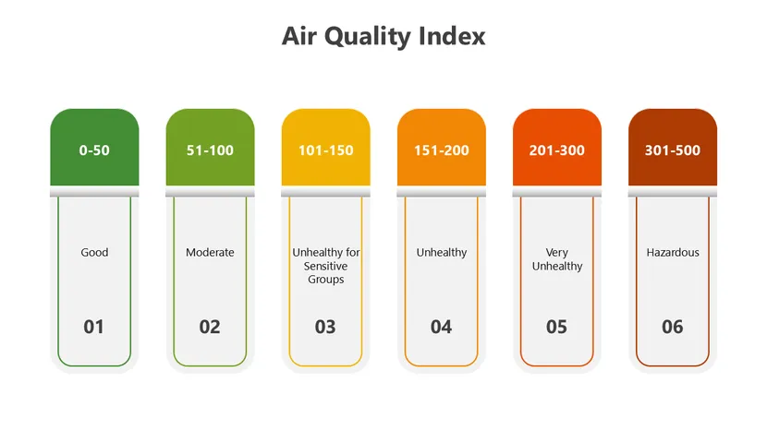

Slide 4
PROBLEM STATEMENT
Current AQI monitoring systems report air quality conditions but do not provide reliable forecasts.
AQI fluctuates due to changing pollutant concentrations and environmental conditions.
Existing monitoring systems primarily provide real-time AQI values.
Sudden deterioration in air quality can impact public health and daily activities.
Lack of forecasting limits proactive decision-making and early intervention.

Slide 5
OBJECTIVE
✓ Build AQI prediction models. ✓ Compare regression algorithms. ✓ Evaluate performance using MAE, MSE, RMSE, R². ✓ Identify the best-performing model. ✓ Deploy the model using Streamlit.
Develop and evaluate machine learning models for accurate AQI prediction.
To predict the AQI using historical pollutant data we are going to :

Slide 6
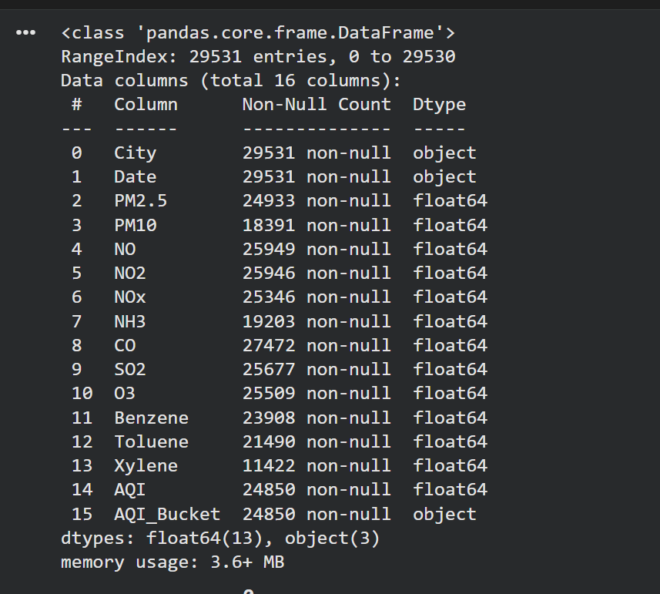
Dataset Overview
AQI is influenced by multiple pollutant concentrations measure over time.
Features Used :
PM2.5 - Particulate Matter 2.5
PM10 - Particulate Matter 10
NO - Nitrogen Monoxide
NO2 - Nitrogen Dioxide
NOx - Nitrogen Oxides
NH3 - Ammonia
CO - Carbon Monoxide
SO2 - Sulphur Dioxide
O3 - Ozone
AQI - Target variable
Source : Air Quality Dataset (Kaggle)
File name : city_day.csv

Slide 7
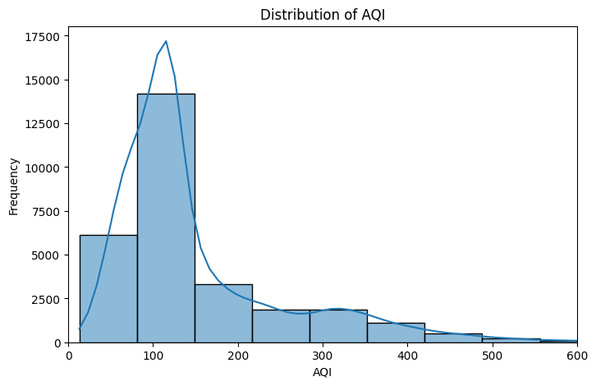
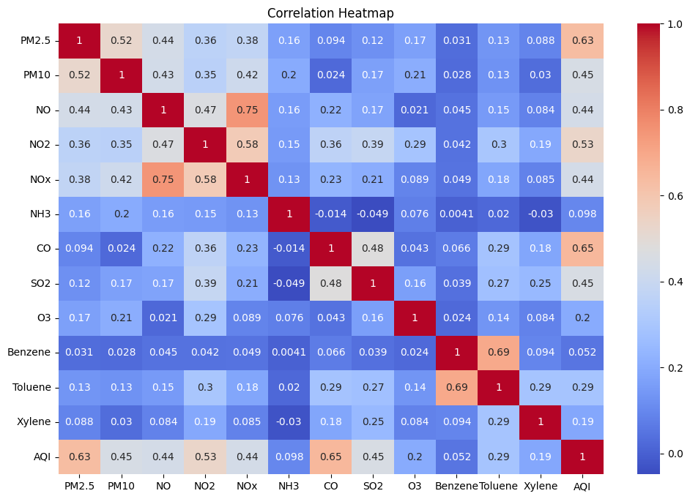
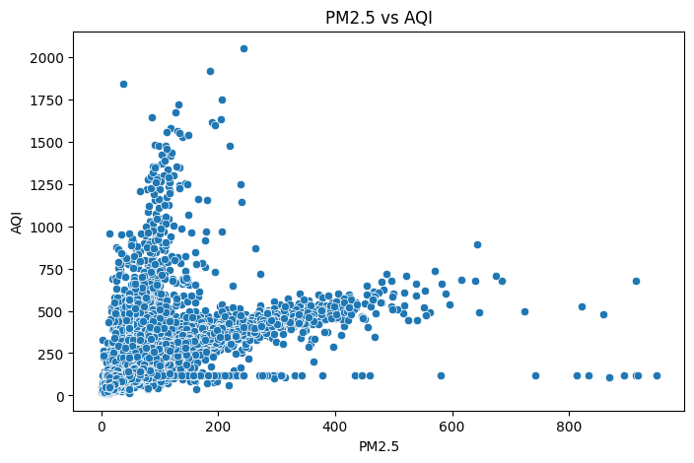
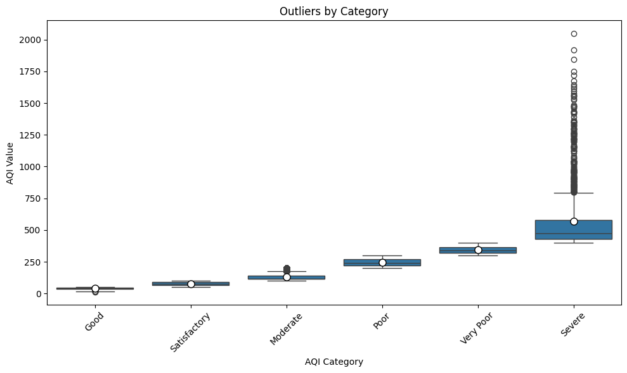
Exploratory Data Analysis
Distribution Analysis: Identified skewness and spread.
Correlation Analysis:
Identified highly influential features.
Scatterplot Analysis:
Higher PM 2.5 levels are associated with higher AQI values.
Boxplot Analysis:
AQI increases with more variability levels.
Higher pollutant concentrations generally corresponded to higher AQI values.

Slide 8
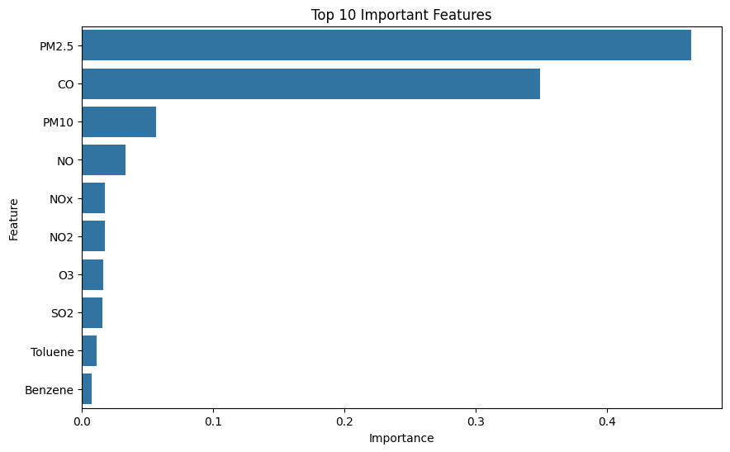
Feature Importance
It helps identify which pollutants contribute most to AQI prediction and explains how it makes decisions.
PM 2.5 is the strongest predictor of AQI.
Gaseous pollutants contributed less than particulate matter.
Model predictions were primarily driven by pollution concentration levels.

Slide 9
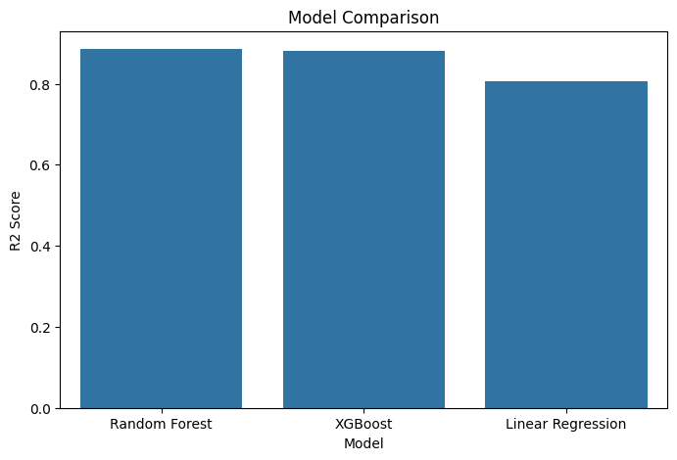
Model Comparison + Selection
Random Forest
XGBoost
Linear Regression
Ensemble of multiple decision trees.
Handles non-linear relationships.
Reduces overfitting.
Gradient Boosting algorithm.
High precision accuracy.
Efficient for complex datasets.
Simple and interpretable model.
Linear representation.
Fast training and prediction.
Random Forest performed the best.

Slide 10

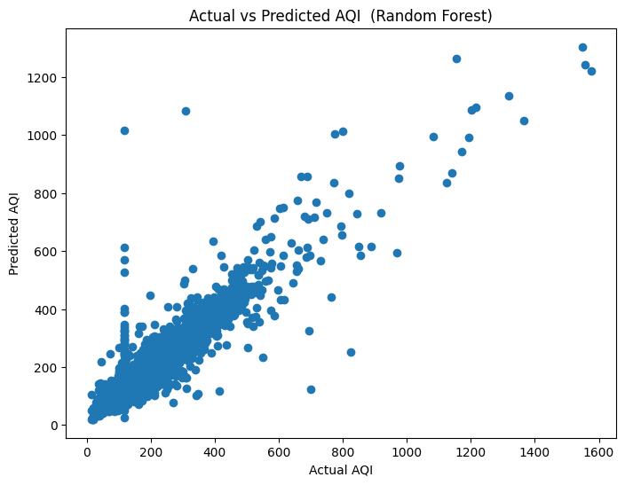
Performance Evaluation
Performace Metrics:
Actual vs Predicted AQI:
MAE (Mean Absolute Error):
Measures the average difference between actual and predicted AQI values.
MSE ( Mean Squared Error):
Measures the squared prediction errors, giving higher weight to large errors.
RMSE ( Root MSE):
Represents the prediction error in AQI units and indicates model accuracy.
R² Score:
Indicates how well the model explains the variability in AQI values.

Slide 11
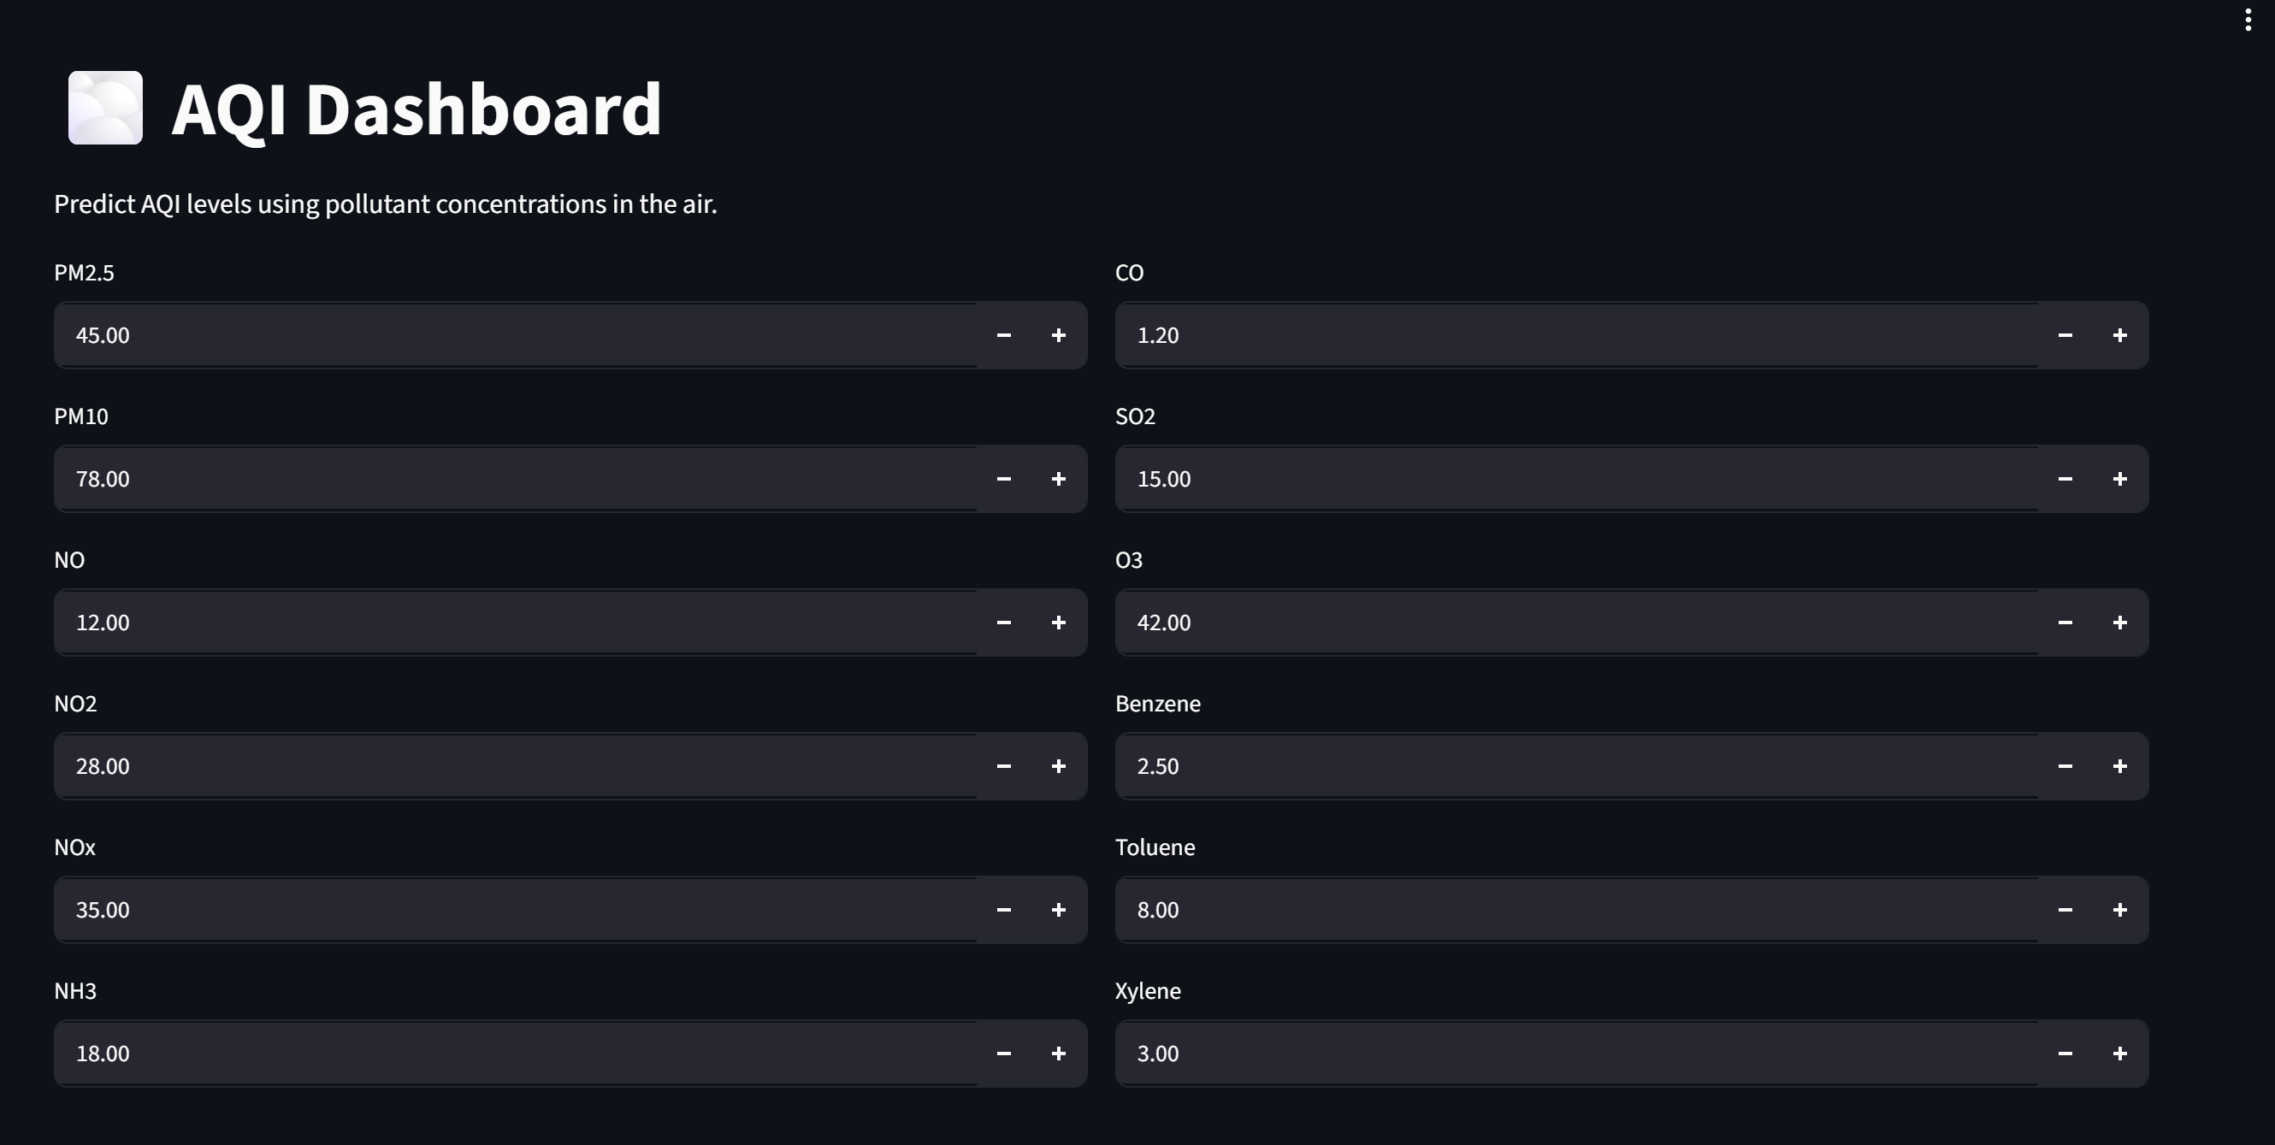


Streamlit Deployment
Streamlit Link
.

Slide 12
CONCLUSION
Developed an end to end AQI prediction pipeline.
Performed data preprocessing and exploratory data analysis
Evaluated and compared the three regression models.
Random Forest achieved the best prediction accuracy (R² = 0.886)
PM 2.5 was identified as the most influential feature affecting AQI.
Successfully deployed the model using Streamlit.
“Predicting air quality today helps protect public health tomorrow.”

Slide 13
THANK YOU!!
You can enter a subtitle here if you it

